Slide 1

Earth’s Features
Experience 5
Fast or Slow
https://sites.google.com/wflboces.org/boces4science/home
Grade 2

Slide 2
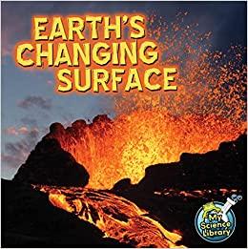
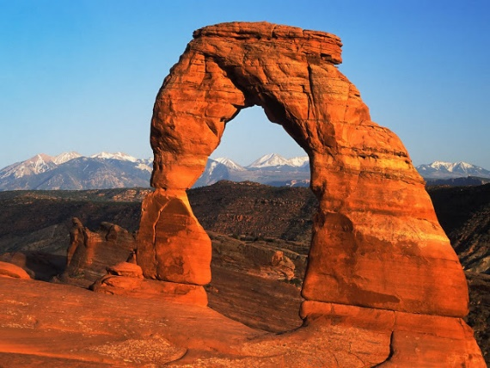
Do earth events happen fast or slow?
Earth Events can happen quick or slow.
  Something that happens quickly we can see happen immediately.
  Something that happens slowly we can not see it happen right in front of us or in a period of time that we can see immediately.
  Quick events:
  earthquakes, eruptions, floods, mudslides, hurricanes, tornadoes, blizzards
  Slow events:
  erosion, weathering, mountain building, glaciers melting,
  Information and activities related to natural events:
https://blog.littlelives.com/explain-to-kids-natural-disasters-97a2d297501

Slide 3
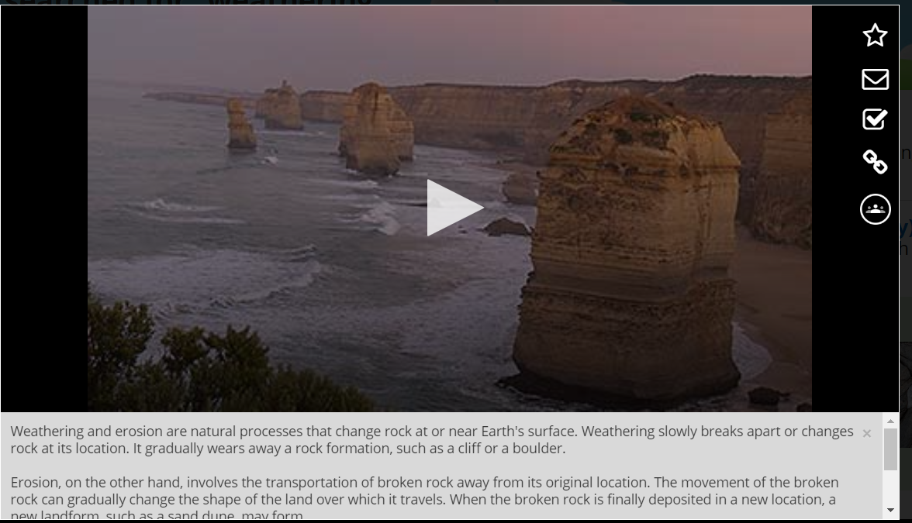
Learn about earth events
Students can go back to their event and find out if it is quick or slow.
  Dr. Binocs has several individual videos about different events:
    https://www.youtube.com/watch?v=HaEmIakO7f4 - compilation of events
    https://www.youtube.com/watch?v=dJpIU1rSOFY – Earthquakes
    https://www.youtube.com/watch?v=MfsugkikLJI&t=48s – Tsunami
    https://www.youtube.com/watch?v=EpuDYZ_g0yg –Tornadoes
    https://www.youtube.com/watch?v=J2__Bk4dVS0 – Hurricanes
https://www.youtube.com/watch?v=SxdaXGgoQW8 - Rock slide (1:47)
https://school.eb.com/levels/elementary/search/articles?query=weathering– weathering (this is through NOVEL NY: https://novelnewyork.org/databases.php
https://site.pebblego.com/modules/2/categories/2967 - Pebble Go has great resources
    Pick an Earth event, learn about it, draw it, write about it, explain how it is slow or fast.

Slide 4
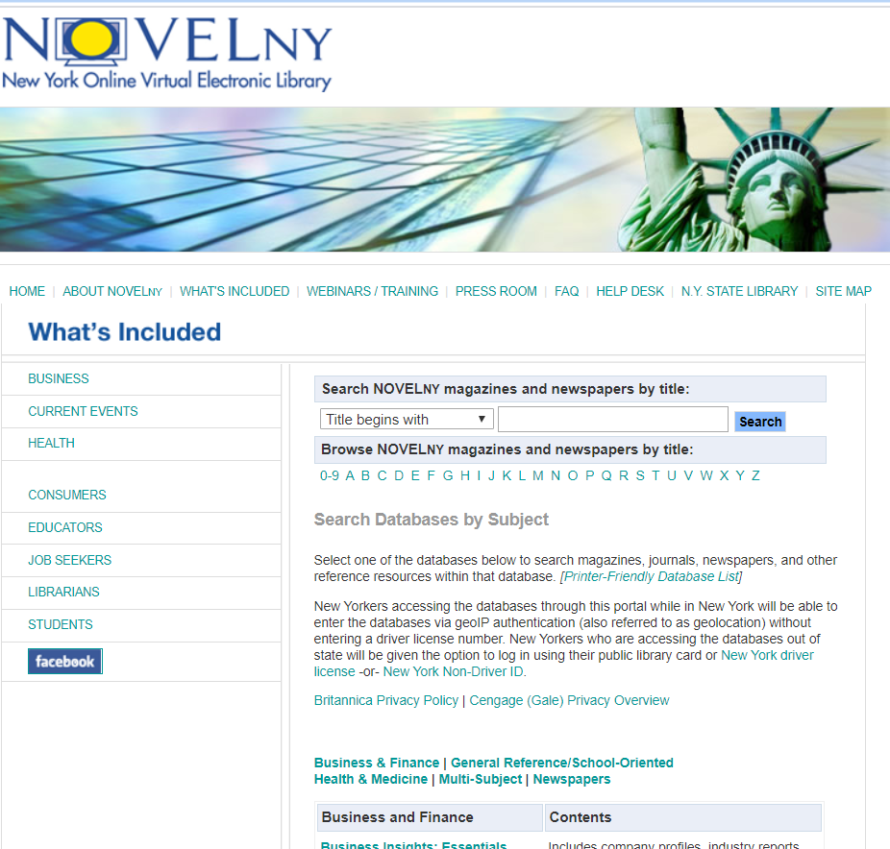
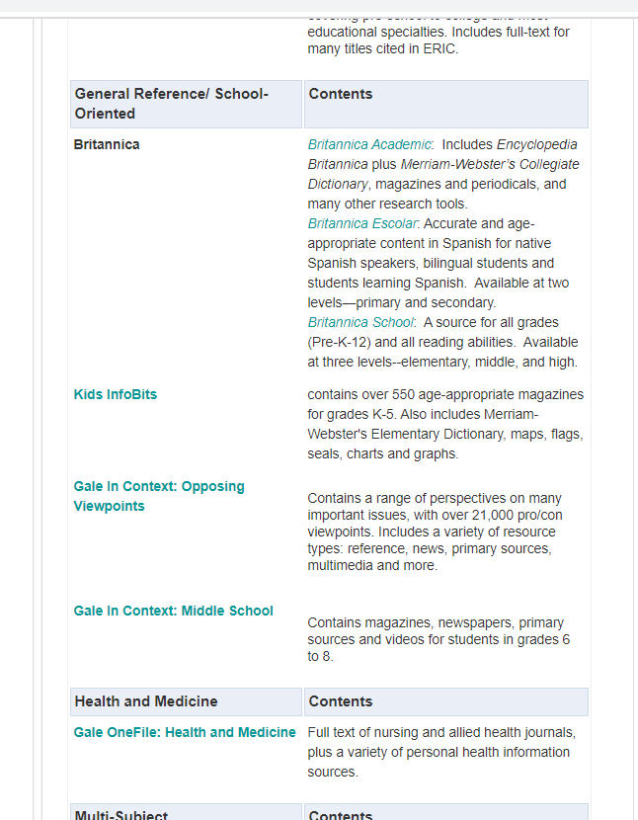
NovelNY data bases
https://novelnewyork.org/databases.php
Once in Novel, on the right side, scroll down to General Reference/ School Oriented. In that section, under Britannica look for Britannica School. Once in there search for your topic in this case “weathering” will bring up the video.
Kid Info Bits is also a great site.

